Slide 1
Employee Data Analysis using Excel
STUDENT NAME: PRITHI K
REGISTER NO :312209853
NM ID :7690CEFEACE9D5C995A4C3541A3517C0
DEPARTMENT :B.COM (ACCOUNTING & FINANCE)
COLLEGE : VALLIAMMAL COLLEGE FOR WOMEN

Slide 2
PROJECT TITLE
Employee Performance Analysis using Excel

Slide 3


AGENDA
Problem Statement
Project Overview
End Users
Our Solution and Proposition
Dataset Description
Modelling Approach
Results and Discussion
Conclusion
3/21/2024 Annual Review

Slide 4

PROBLEM STATEMENT
By conducting a thorough performance analysis across multiple departments, the progress and growth of individual employees. This evaluation yields two key outcomes: identifying areas for employee development and gaining valuable insights into departmental performance and growth. Armed with this information, the organization can make data-driven decisions, establish achievable goals, and develop targeted strategies to foster departmental excellence and propel business success.

Slide 5

PROJECT OVERVIEW
The performance analysis is the evaluation and interpretation of data to assess the performance of an individual, team, department, or organization. The goal of performance analysis is to provide actionable insights that enable organizations to make informed decisions, improve performance, and achieve their objectives.

Slide 6



WHO ARE THE END USERS?
The end-users of performance analysis include management, HR, employees, board of directors, investors, and regulatory bodies. These individuals utilize performance analysis to drive business success, employee growth, and informed decision-making, enabling them to evaluate performance, identify areas for improvement, and make strategic decisions that impact the organization's growth and success

Slide 7


OUR SOLUTION AND ITS VALUE PROPOSITION
Pivot table
Conditional formatting
Filter
Graphical representation

Slide 8
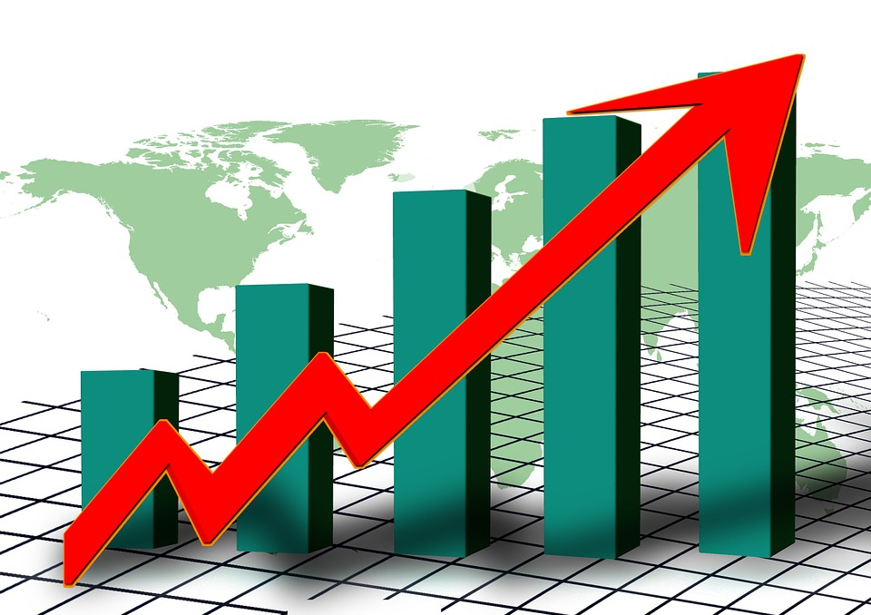
Dataset Description
Employee data kaggle website
Features used for preparing performance analysis:
Employee ID
First name
Last name
Gender
Departments
Business unit
v

Slide 9

THE "WOW" IN OUR SOLUTION
Formula used to evauvate the performance level:
=IFS(Z2>=5,”VERY HIGH”,Z2>=4 ,”HIGH”,Z2>=3,”MEDIUM”,TRUE,”LOW”)
(ii) PIVOT TABLE
(iii)RECOMMENDED CHART
3/21/2024 Annual Review
9

Slide 10
MODELLING
1)Data collection :The data regarding the employees are downloaded from Kaggle website.
2)Features :-All the features are identified, based on the requirement the data is selected.
3)Data cleaning :-The empty cell are filtered using Sort and filter(Filter by colour).
4)Performance leveI :- The performance level classified into very high ,high, medium, low to improve organisational growth.
5)Data visualization :- Graphical representation is presented for easy and quick understanding about the performance of the employees in the organisation
10

Slide 11
RESULTS
11

Slide 12

conclusion
The performance analysis reveals a mixed landscape, with notable strengths and areas for improvement. We've identified instances of Very High Performance, demonstrating exceptional excellence, and High Performance, exceeding expectations. However, some areas fell short, showing Low Performance, requiring targeted support. Additionally, Medium Performance was observed in certain segments, leaving room for growth. By acknowledging and addressing these variations, we can optimize resources, drive improvement, and achieve our organizational objectives.

